Slide 1
CSE 3400 - Introduction to Computer & Network Security (aka: Introduction to Cybersecurity) Lecture 7 Hash Functions – Part II
Ghada Almashaqbeh
UConn
From Textbook Slides by Prof. Amir Herzberg
UConn

Slide 2
Outline
Hash based MACs.
Domain extension.
Merkle digest and Merkle trees.
Blockchains.
2

Slide 3
Hash based MAC
Hash-based MAC is often faster than block-cipher MAC
How? Heuristic constructions:
Are these secure assuming CRHF ? OWF ? Both ?
No.
But: all ‘secure in random oracle model’
Notes:
3
(c) Amir Herzberg, http://AmirHerzberg.com, Bar Ilan University
04/07/06

Slide 4
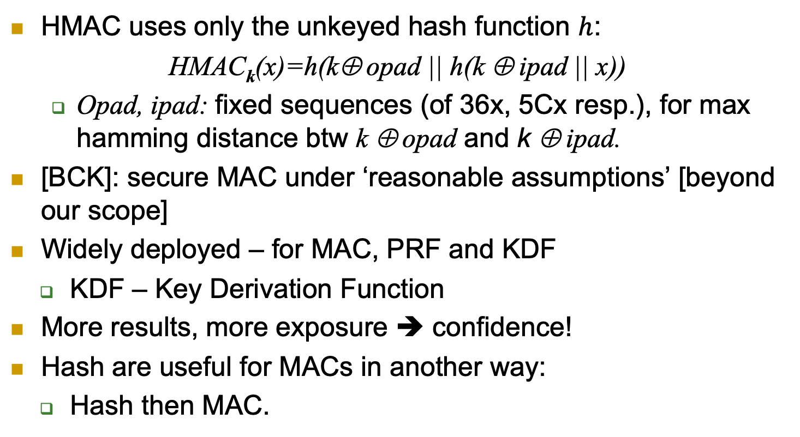
Hash-based MAC: HMAC
HMAC uses only the unkeyed hash function $h$:
HMAC_{k}(x)=h(k⊕ opad || h(k ⊕ ipad || x))
Opad, ipad: fixed sequences (of 36x, 5Cx resp.), for max hamming distance btw k ⊕ opad and k ⊕ ipad.
[BCK]: secure MAC under ‘reasonable assumptions’ [beyond our scope]
Widely deployed – for MAC, PRF and KDF
KDF – Key Derivation Function
More results, more exposure ➔ confidence!
Hash are useful for MACs in another way:
Hash then MAC.
Notes:
4
(c) Amir Herzberg, http://AmirHerzberg.com, Bar Ilan University
04/07/06

Slide 5
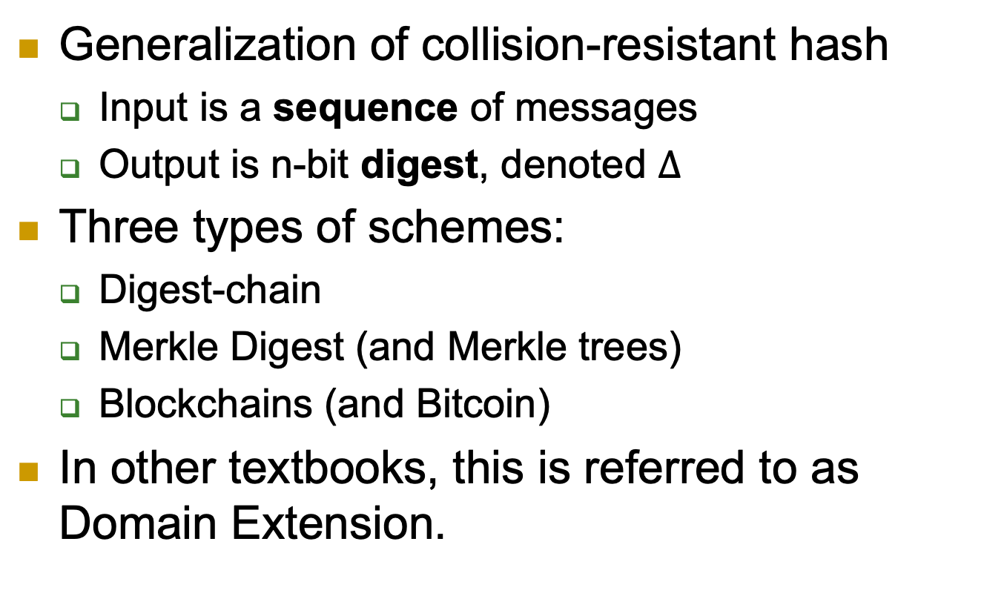
Digest Schemes
Generalization of collision-resistant hash
Input is a sequence of messages
Output is n-bit digest, denoted $Δ$
Three types of schemes:
Digest-chain
Merkle Digest (and Merkle trees)
Blockchains (and Bitcoin)
In other textbooks, this is referred to as Domain Extension.

Slide 6
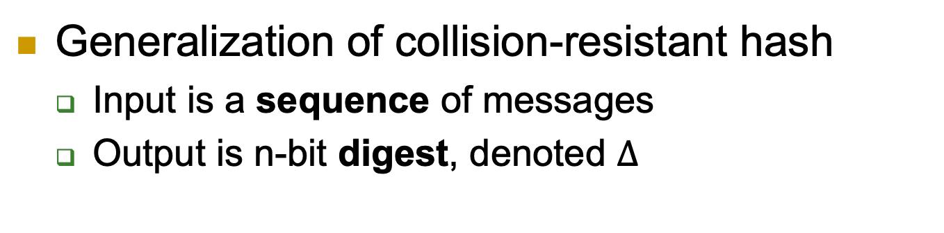
Digest-Chain Schemes
Generalization of collision-resistant hash
Input is a sequence of messages
Output is n-bit digest, denoted $Δ$

Slide 7
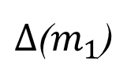

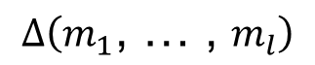


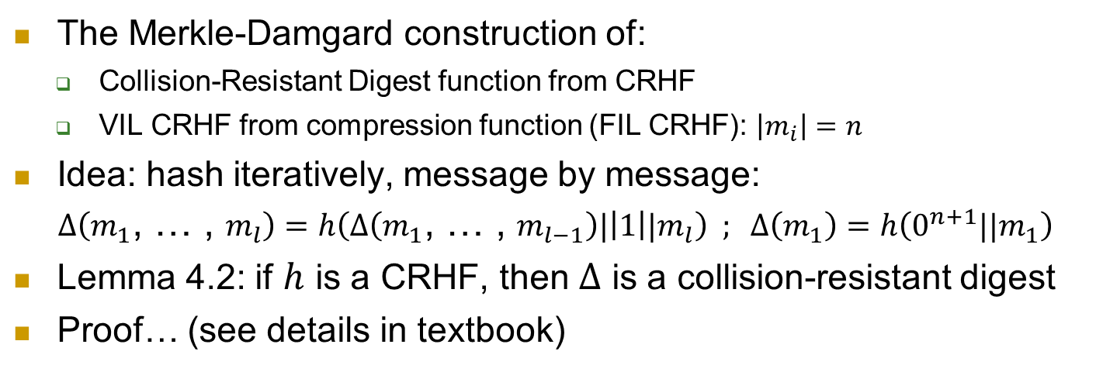

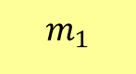
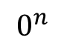
The Merkle-Damgard Digest Function
The Merkle-Damgard construction of:
Collision-Resistant Digest function from CRHF
VIL CRHF from compression function (FIL CRHF): $\left|m_{i}\right|=n$
Idea: hash iteratively, message by message:
$Δ\left(m_{1}\text{, … , }m_{l}\right)=h\left(Δ\left(m_{1}\text{, … , }m_{l−1}\right)|\left|1\right||m_{l}\right) ; Δ\left(m_{1}\right)=$ $h\left(0^{n+1}||m_{1}\right)$
Lemma 4.2: if $h$ is a CRHF, then $Δ$ is a collision-resistant digest
Proof… (see details in textbook)
$$m_{1}$$
…
$$m_{l}$$
$$0$$
$$1$$
h
h
$$Δ\left(m_{1}\text{, … , }m_{l}\right)$$
$$0^{n}$$
$Δ$($m_{1}$)
$Δ$($m_{1},..,$ $m_{l−1}$)
Notes:
7
(c) Amir Herzberg, http://AmirHerzberg.com, Bar Ilan University
04/07/06

Slide 8
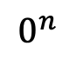
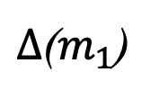
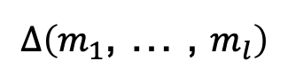
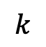



$$m_{1}$$
…
$$m_{l}$$
$$k$$
$$0$$
$$1$$
h
h
$$Δ\left(m_{1}\text{, … , }m_{l}\right)$$
$$0^{n}$$
$Δ$($m_{1}$)
$Δ$($m_{1},..,$ $m_{l−1}$)

Slide 9
VIL CRHF from FIL CRHF
Recall: design and cryptanalyze simple (FIL) function, use it to construct strong (VIL) function
Build VIL CRHF {0,1}*→{0,1}^{n} from FIL CRHF (aka compression function) comp:{0,1}^{m}→{0,1}^{n}
E.g. m=2n , i.e. comp:{0,1}^{2n}→{0,1}^{n}
The Merkle-Damgard constructs a CRHF from a compression function
Requires `MD-strengthening’ extension [see text]
x₁∈{0,1}^{n}
comp
comp(x₁,x₂)∈{0,1}^{n}
x₂∈{0,1}^{n}
Notes:
9
(c) Amir Herzberg, http://AmirHerzberg.com, Bar Ilan University
04/07/06

Slide 10
Merkle - Damgard Length-Padding
Aka Merkle - Damgard Strengthening
Let pad(x)=1||0^{k}||bin (|x|) ; x’=x||pad(x)
Where bin (|x|) is the L–bit binary representation of |x|
And: |x|+|pad(x)|≡0 mod L
Simplify: assume |x|≡0 mod L, |pad(x)|=L
Let y₀=IV be some fixed L bits (IV=Initialization Value)
For i=1,..|x’|/L let y_{i}=c(x’[i],y_{i-1})
Output MD[c]_{IV}(x)=y_{l+1}
This is just a high level idea, care needed to avoid collisions
x[1]
x[2]
…
x[l]||10^{k}
bin(|x|)
IV
c
c
c
c
h(x)=y_{l+1}=c(|x|,y_{l})
Notes:
10
(c) Amir Herzberg, http://AmirHerzberg.com, Bar Ilan University
04/07/06

Slide 11
The Digest-Chain Extend Function
Beyond digest and collision resistance: sequence-related integrity mechanisms
For digest-chain, the extend function:
Input: digest and ‘next’ sequence
Output: digest (of entire sequence)
Correctness requirement:
Use to (1) extend chain, (2) validate new digest (with new seq.), or (3) use digest to validate a message

Slide 12
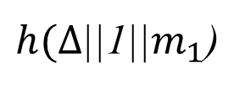
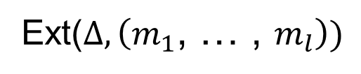



The Merkle-Damgard Extend Function
We can define Extend for Merkle-Damgard:
Idea: Just continue last digest!
Not secure to be used to construct a MAC!
$$m_{1}$$
…
$$m_{l}$$
$$0$$
$$1$$
Ext($Δ,\left(m_{1}\text{, … , }m_{l}\right))$
$$Δ$$
h
$h(Δ$||1||$m_{1}$)
h
Notes:
12
(c) Amir Herzberg, http://AmirHerzberg.com, Bar Ilan University
04/07/06

Slide 13
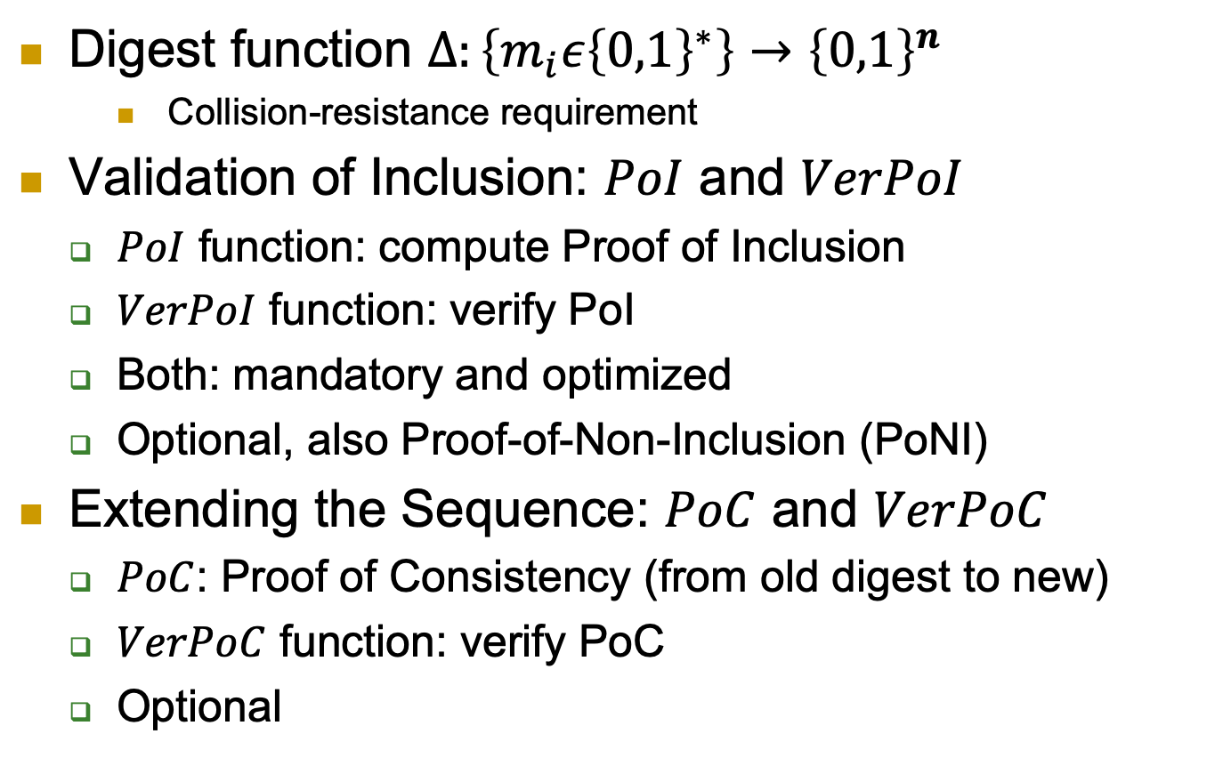
Merkle Digest Schemes
Digest function $∆:\left\{m_{i}ε{\left\{0,1\right\}}^{∗}\right\}→{\left\{0,1\right\}}^{n}$
Collision-resistance requirement
Validation of Inclusion: $PoI$ and $VerPoI$
$PoI$ function: compute Proof of Inclusion
$VerPoI$ function: verify PoI
Both: mandatory and optimized
Optional, also Proof-of-Non-Inclusion (PoNI)
Extending the Sequence: $PoC$ and $VerPoC$
$PoC$: Proof of Consistency (from old digest to new)
$VerPoC$ function: verify PoC
Optional

Slide 14
Merkle digest scheme: definition

Slide 15
Merkle digest: correctness and security

Slide 16
Proof of Consistency (PoC)
A Merkle digest scheme supports PoC if it has two more functions:
Correct PoC:

Slide 17
Secure Proof of Consistency
To be consistent with previous slides, replace B_{A} with B_{CN}

Slide 18





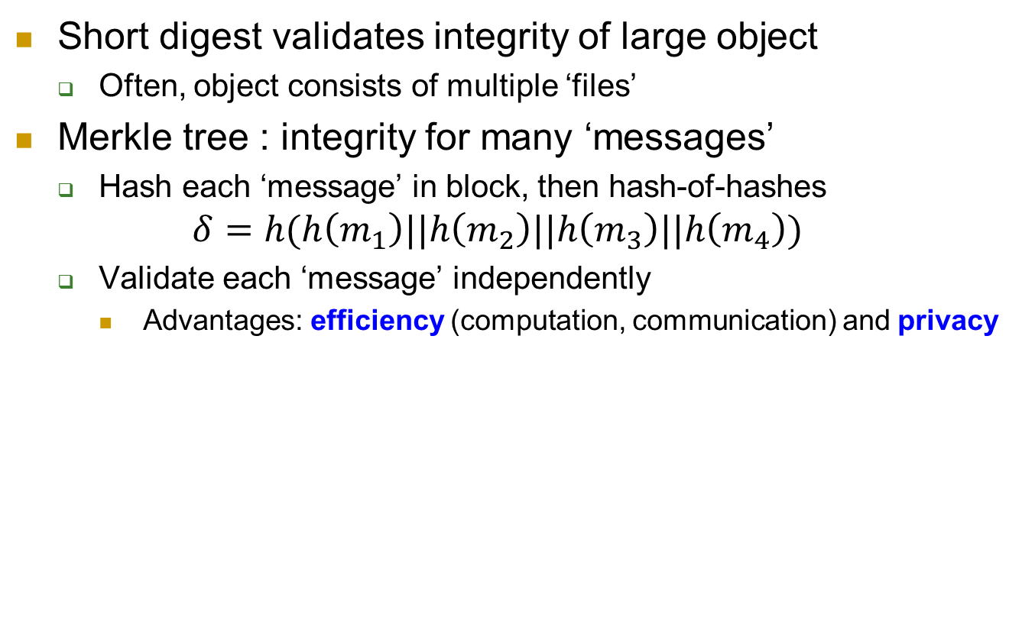








Two-layered Merkle tree
Short digest validates integrity of large object
Often, object consists of multiple ‘files’
Merkle tree : integrity for many ‘messages’
Hash each ‘message’ in block, then hash-of-hashes $δ=h(h\left(m_{1}\right)||h\left(m_{2}\right)||h\left(m_{3}\right)||h\left(m_{4}\right))$
Validate each ‘message’ independently
Advantages: efficiency (computation, communication) and privacy
$$m_{1}$$
$$m_{2}$$
$$m_{3}$$
$$m_{4}$$
$$h$$
$$h$$
$$h$$
$$h$$
$$h(m_{1})$$
$$h(m_{2})$$
$$h(m_{3})$$
$$h(m_{4})$$
$$h$$
$$δ$$

Slide 19
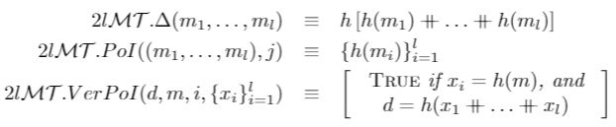





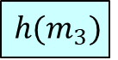


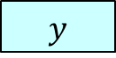








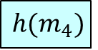
Two-layered Merkle tree
Hash each item in block separately: $x_{1}=h\left(m_{1}\right),x_{2}=h\left(m_{2}\right), …$
Digest is hash of hashes: $y=∆\left(m_{1}\text{,}m_{2}\text{,…}\right)=h\left(x_{1},x_{2}, … \right)$
$$m_{1}$$
$$m_{2}$$
$$m_{3}$$
$$m_{4}$$
$$h$$
$$h$$
$$h$$
$$h$$
$$h(m_{1})$$
$$h(m_{2})$$
$$h(m_{3})$$
$$h(m_{4})$$
$$x_{1}$$
$$x_{2}$$
$$x_{4}$$
$$h$$
$$y$$
Allows each user to receive, validate only required items. How?

Slide 20
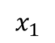


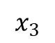

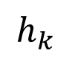

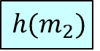
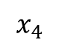

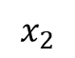
To verify inclusion of $m_{2}…$
$$m_{2}$$
$$h$$
$$x_{1}$$
$$x_{4}$$
$$h(m_{2})$$
$$x_{3}$$
$$x_{2}$$
$$h_{k}$$
$$d$$
Receive and validate only $m_{2}$. Other hashes still required, though.

Slide 21
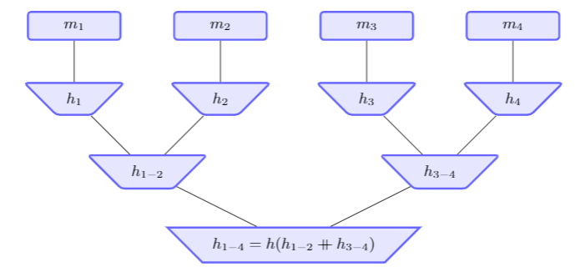
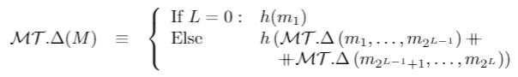
The Merkle Tree Construction
Reduce length of ‘proofs’ – send less hashes of ‘other msgs’
Notes:
21
(c) Amir Herzberg, http://AmirHerzberg.com, Bar Ilan University
04/07/06

Slide 22


Merkle Tree: Proof of Inclusion (PoI)
To prove inclusion of $m_{3}$ , send also ‘proofs’: $h_{1−2}$, $h_{4}$
Notes:
22
(c) Amir Herzberg, http://AmirHerzberg.com, Bar Ilan University
04/07/06

Slide 23
Blockchains
Next slides set.

Slide 24
Covered Material From the Textbook
Chapter 4
Sections 4.6, 4.7, and 4.8

Slide 25

Thank You!

